Slide 1
What does it mean?
“What upon earth is the matter with the American people?...The national edifice is on fire. Every man who can carry a bucket of water…is wanted…[Yet government leaders] refuse to receive the very class of men which that a deeper interest in the defeat and humiliation of the rebels than all others….Such is the pride, the stupid prejudice and folly that rules the hour.”

Slide 2
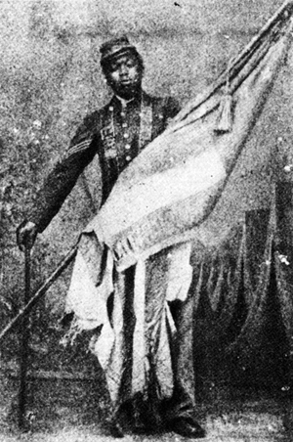
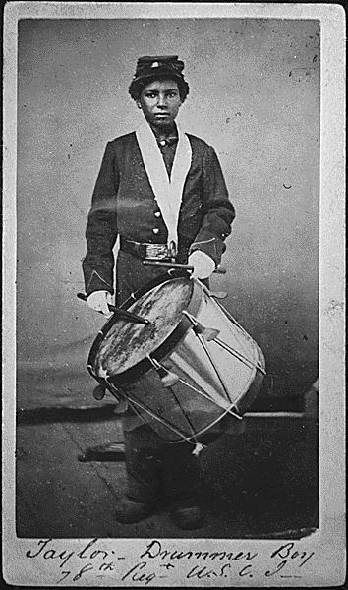

Slide 3
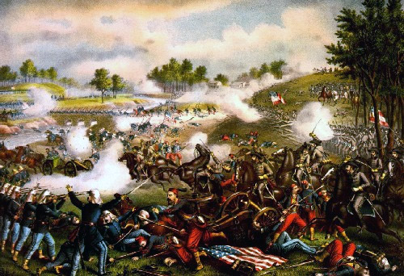
Battle of Bull Run/Manasses
North – McClellan
South – Beauregard
Hoping for quick end to conflict
Neither side prepared
RR town
South brings in fresh troops
North retreats

Slide 4
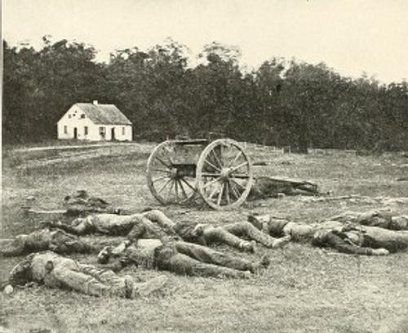
Battle of Antietam
Lee (South) decides to invade the North
If they can win this battle, they might be able to end the war
McClellan (North) finds Lee’s orders wrapped around cigars.
Waits to attack
Bloodiest day of Civil War and American History
North wins

Slide 5
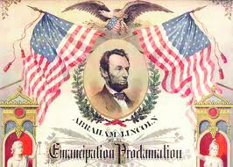
Emancipation Proclamation
Antietam gives Lincoln the courage to issue E.P.
North changes reason for fighting: end slavery!
Jan. 1, 1863 Lincoln frees the slaves in South
Now slaves try even harder to escape
North allows some blacks to fight: Massachusetts 54th.

