Slide 1
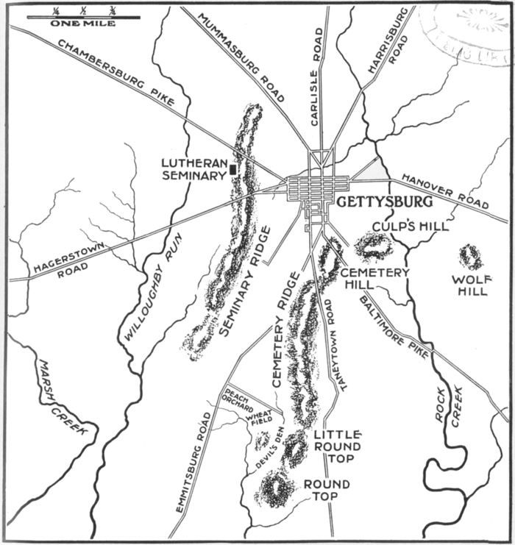
Recreate Battlefield
Seminary Ridge
Cemetery Ridge
Little Round Top
Culp’s Hill
Cemetery Hill
Peach Orchard
City of Gettysburg

Slide 2
Gettysburg
And the Gettysburg Address

Slide 3
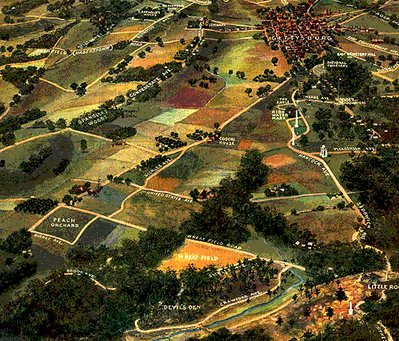
Set up
June1863
Low point in the war for Union
Rumors Lincoln will resign
Union blockade/South lacking resources
South looks to North for supplies and victory to end war

Slide 4
The Battle : Day 1 (July 1)
Confederates looking for shoes→ fight erupts (led by Lee)
3 days long
“Greatest Battle ever fought in North America”
Fought on a series of hills

Slide 5
Day 1 cont:
Union line stretches from Culp’s Hill to Cemetery Ridge to Little Round Top
Confederates along Seminary Ridge
Union has high ground
Fight all day

Slide 6
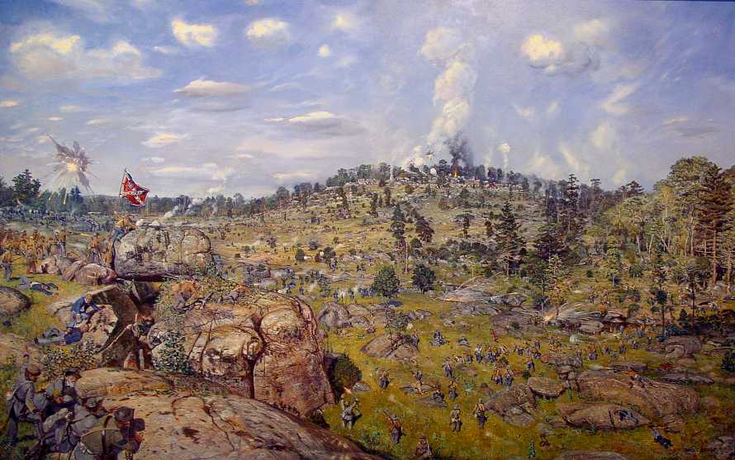
Day 2
Lee orders attack at Little Round Top
Savage fighting erupts around Peach orchard, Devil’s Den and Little Round Top
Union holds the hill

Slide 7
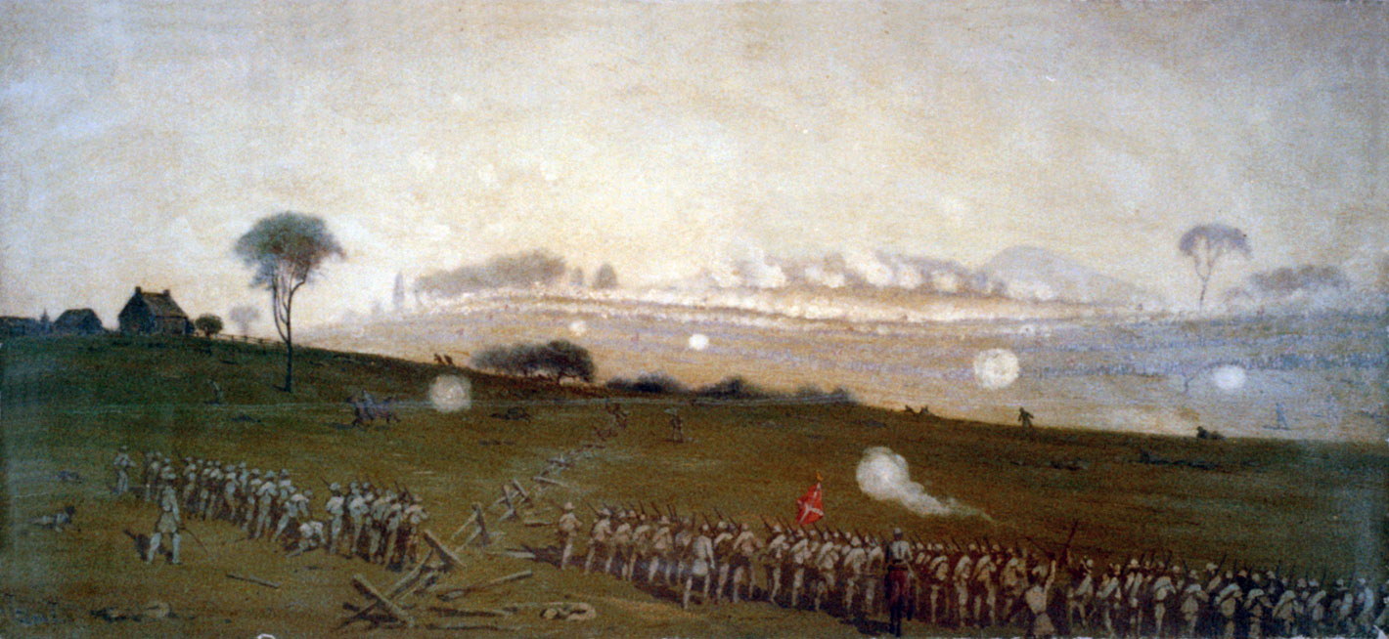
Day 3 (July 3)
Lee begins artillery barrage
Union stops fighting back, South assumes they are out of ammo
Pickets charge
Union resumes fighting
Southern troops lose 1/3 of army

Slide 8
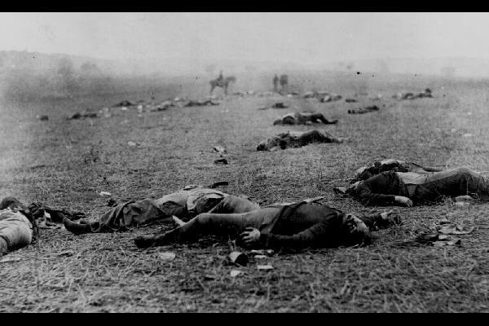
Gettysburg Address
Given by Lincoln at memorial service
Short, not liked by some
Explained the reason for war
Talked of a “new freedom” for all people

