Slide 1
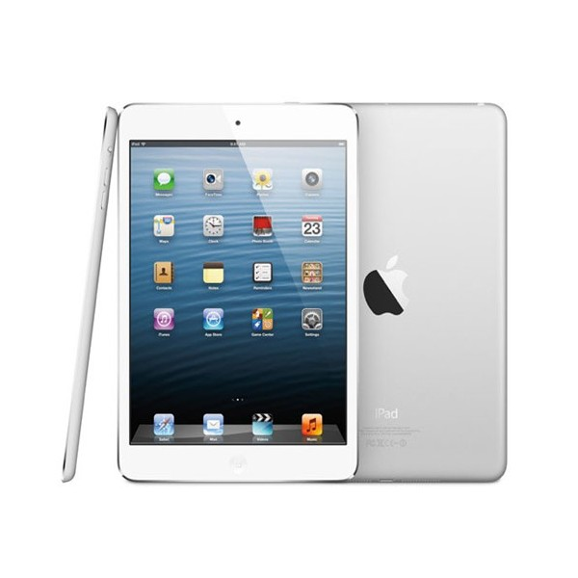
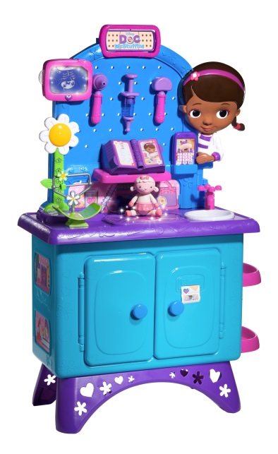
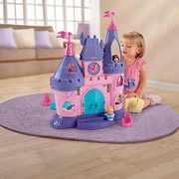
Time to Go shopping. . .
Brian – Apple iPad mini 64 GB in White
Addie – Doc McStuffins Get Better Checkup Center
Ainsley – Fisher Price Little People Disney Princess Songs Palace Play Set
Afton – Graco Sweet Slumber Sound Machine

Slide 2
Market Economy
Development of Consumer America

Slide 3
Farm Economy
Farmers grow enough to provide for their family
No reason to make extra
Buying/selling only with close neighbors
Self-sufficient

Slide 4
Transportation Revolution
New types of transportation develop which change everything!
ROADS, CANALS, RAILROADS

Slide 6
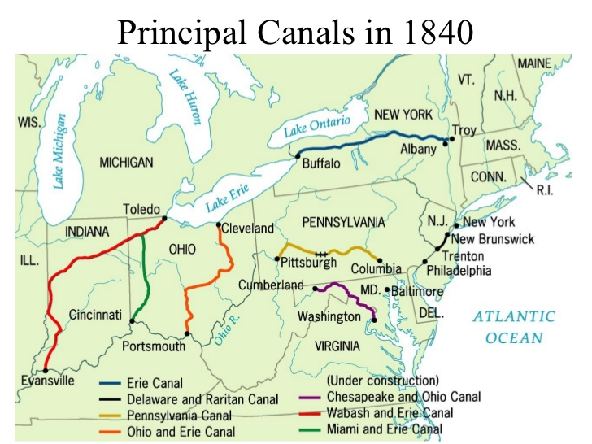

Slide 9
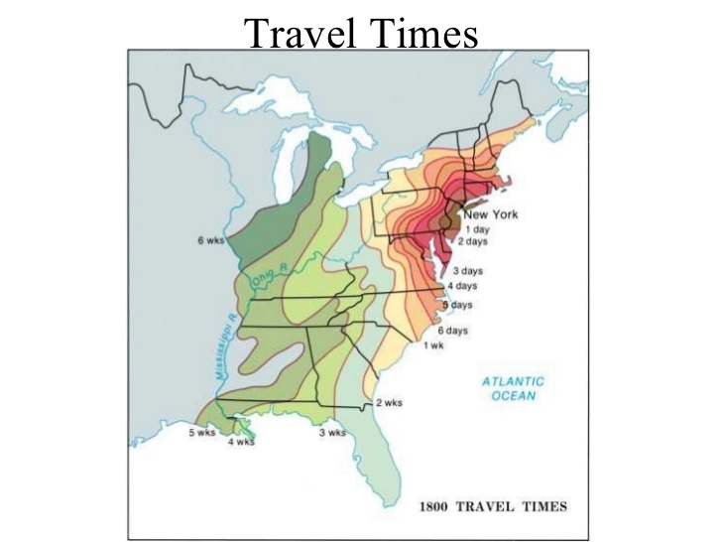

Slide 10
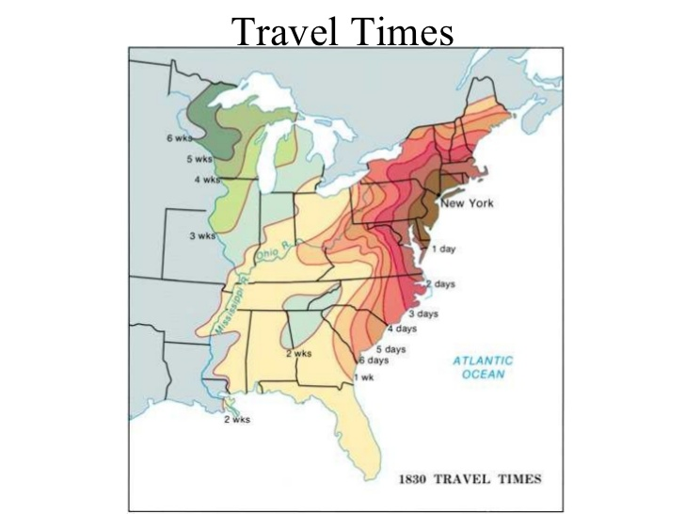

Slide 11
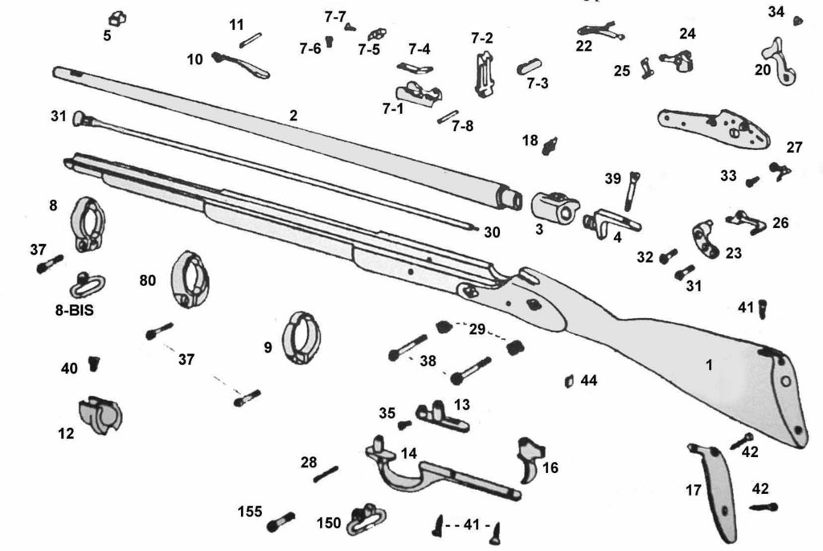
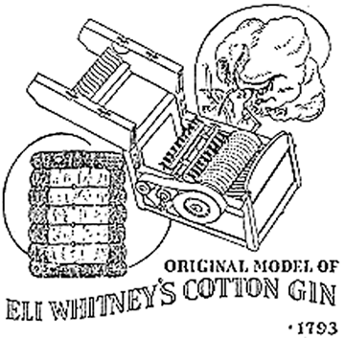
Eli Whitney
Cotton Gin
Interchangeable parts
Allows factories to develop

Slide 12
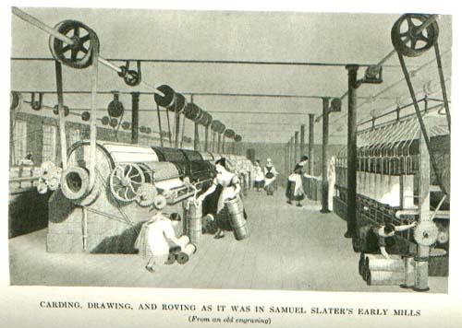
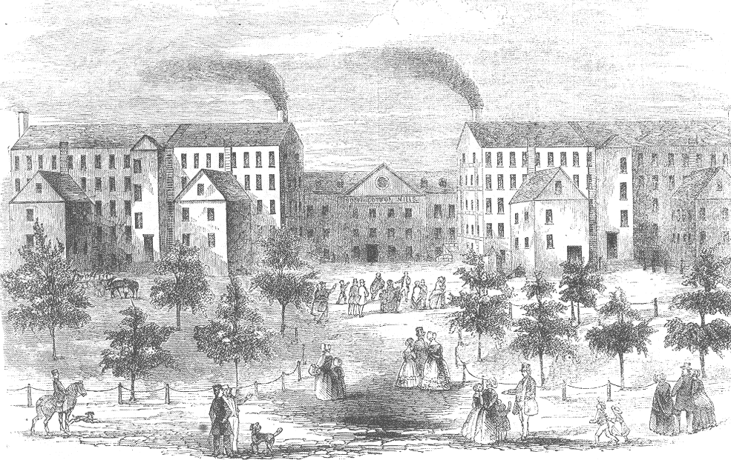
Textile Industry
Samuel Slater
Francis Lowell
Steals mill technology from England (machines)
First mass centralized mill – hires female workers

Slide 13
Mentality shift = make a profit off of the masses

Slide 14
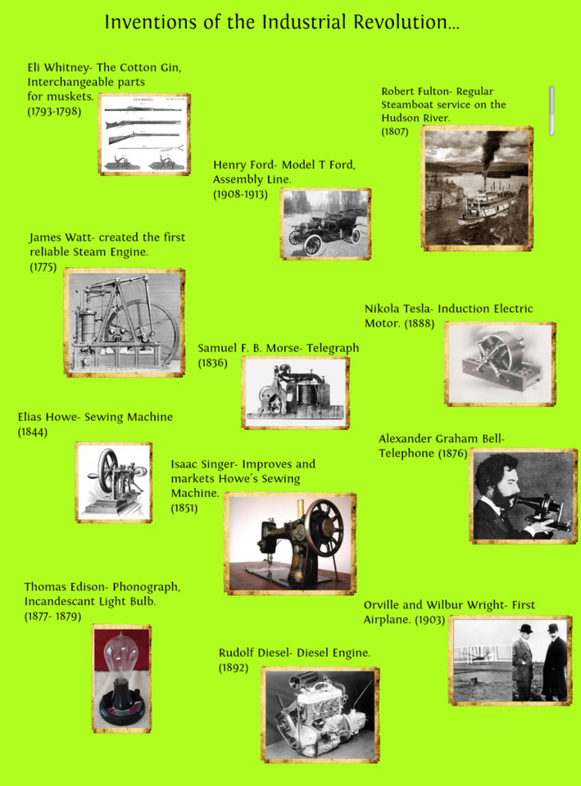
Explosion of Inventions

Slide 15
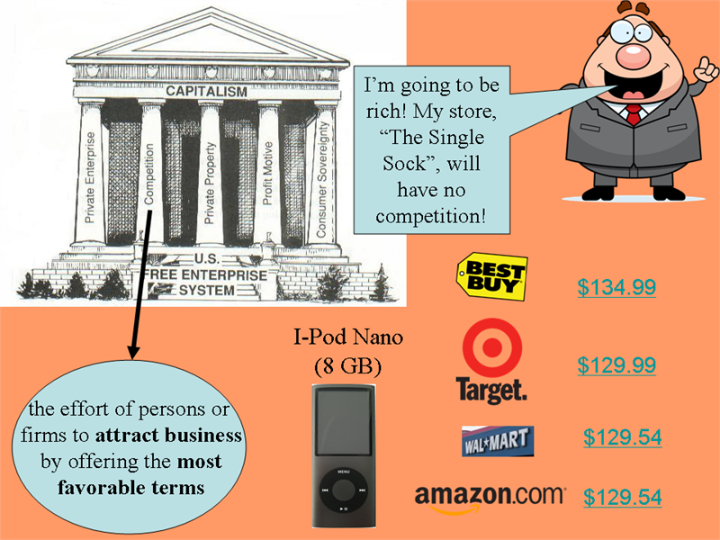
Market Economy - Consumerism

Slide 16
Market Revolution
Companies compete to sell goods to masses
People start to buy and sell goods
Money circulates
America becomes CONSUMERS

Slide 17
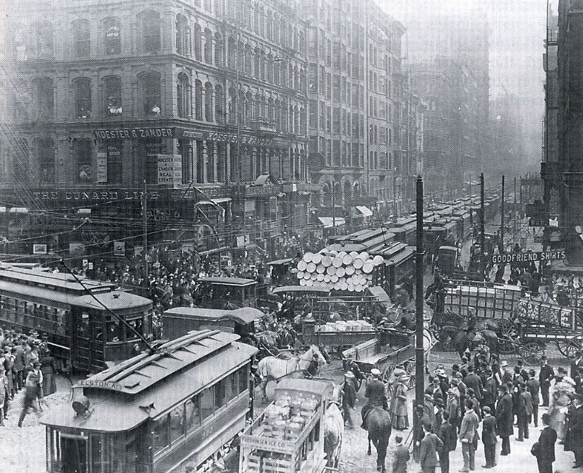
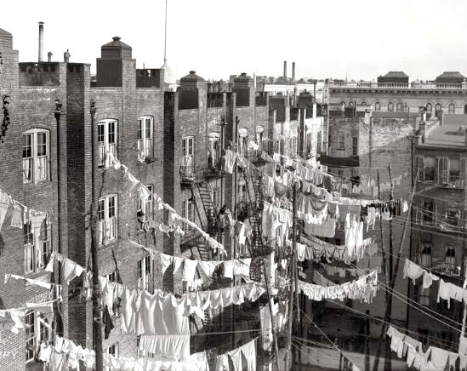
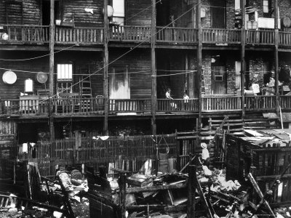
Rise of Large Cities
Move to cities
Cities grow large in Northern states
Population increase
Cities dirty, overcrowded

