Slide 1
Pearl Harbor
America Enters WWII

Slide 2
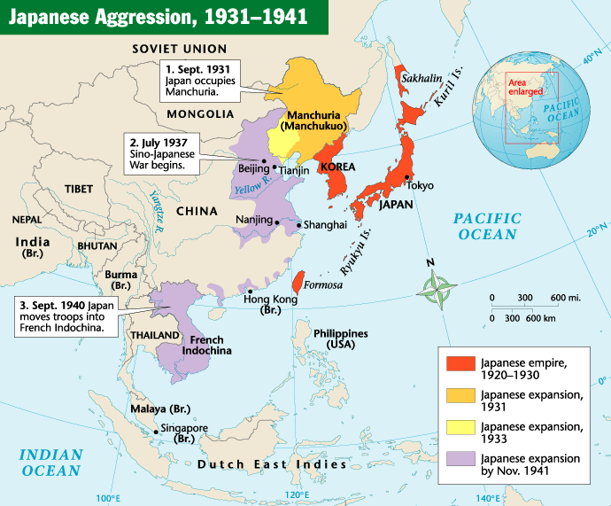

Slide 3
Japan enters the scene
Looking for raw materials, markets and land
Invades Indochina and China
America cuts off trade

Slide 4
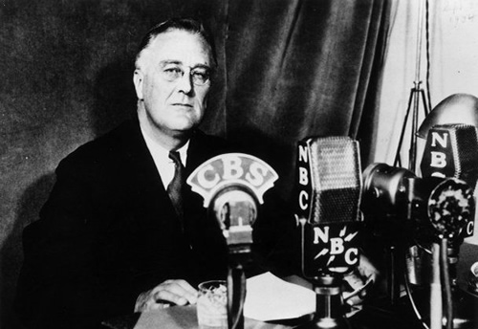
America’s stance
Hitler takes Poland→ war
US neutral
Illegal to sell any weapons to country at war

Slide 5
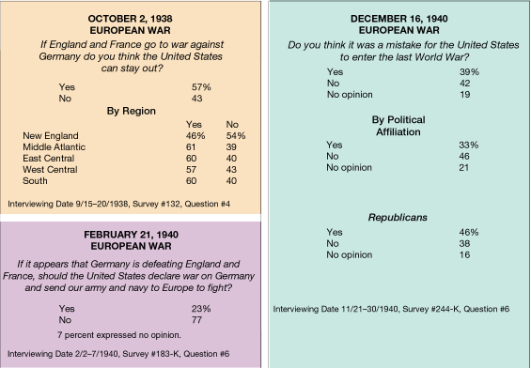

Slide 6
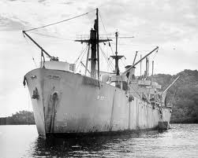
The beginnings of involvement
Cash and Carry Act: sell goods (weapons and supplies) to warring countries BUT they have to pay in cash and transport them.
Destroyers for bases (loophole)

Slide 7
Getting in further
FDR elected 3rd term
Germany getting more powerful
Britain asks for more help
Land-Lease Act: President can give aid to countries whose security is vital to our security ($40 billion)

Slide 8
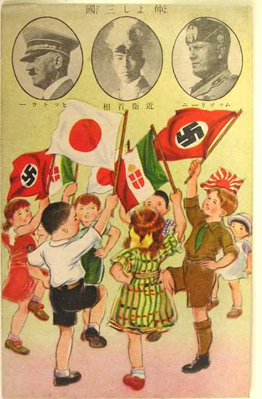
Final Straw
Japan allies with Germany and Italy
U.S. cuts off trade, embargo on oil
Diplomatic negotiations fail

Slide 9
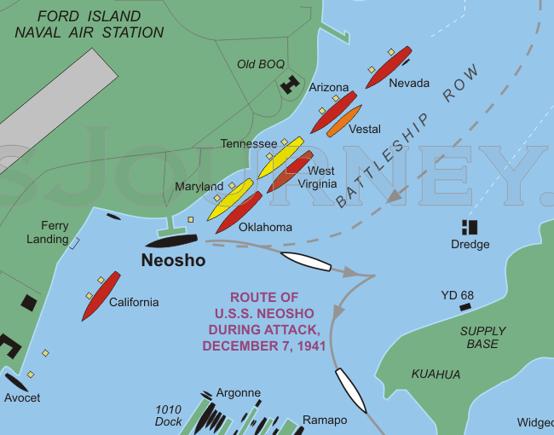
Pearl Harbor – Dec. 7, 1941
Japan wanted complete surprise
Over 2,000 Americans killed
U.S.S. Arizona sunk
America enters the war UNITED!
Allies: GB, Soviets, France, USA
Axis: Germany, Italy, Japan

Slide 10
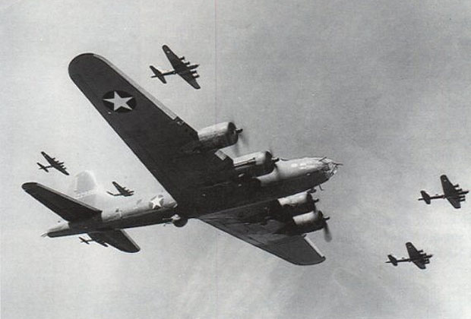
Japan’s goofs!
Sub spotted – gets away
2nd sub spotted – shot down
Planes spotted on radar – excused
Japanese naval fleet is missing

Slide 11
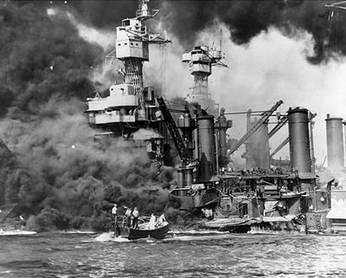
Results
America enters the war UNITED.

