Slide 1
Profiling
Profiling is when someone targets you and labels you with a preconceived stereotype based on your race, religion, ethnicity, age, where you live, where you go to school, who your family is, etc.
Think of a time when you have done this to someone or it has happened to you. Explain in ½ page.

Slide 2
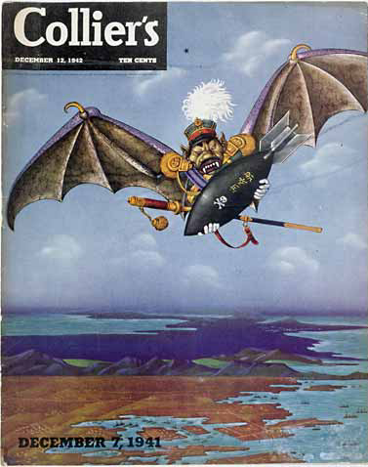

Slide 3
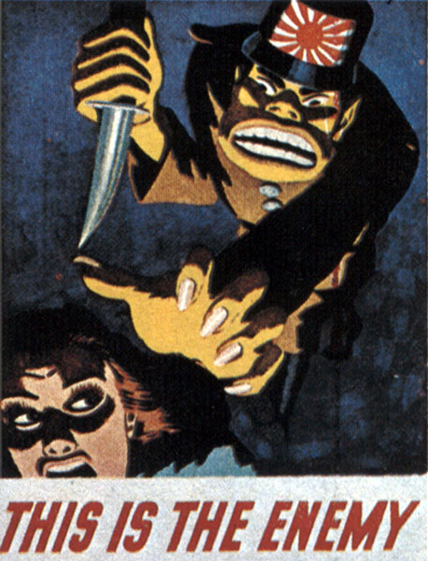

Slide 4
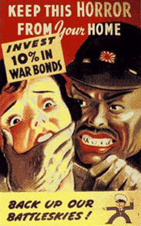

Slide 5
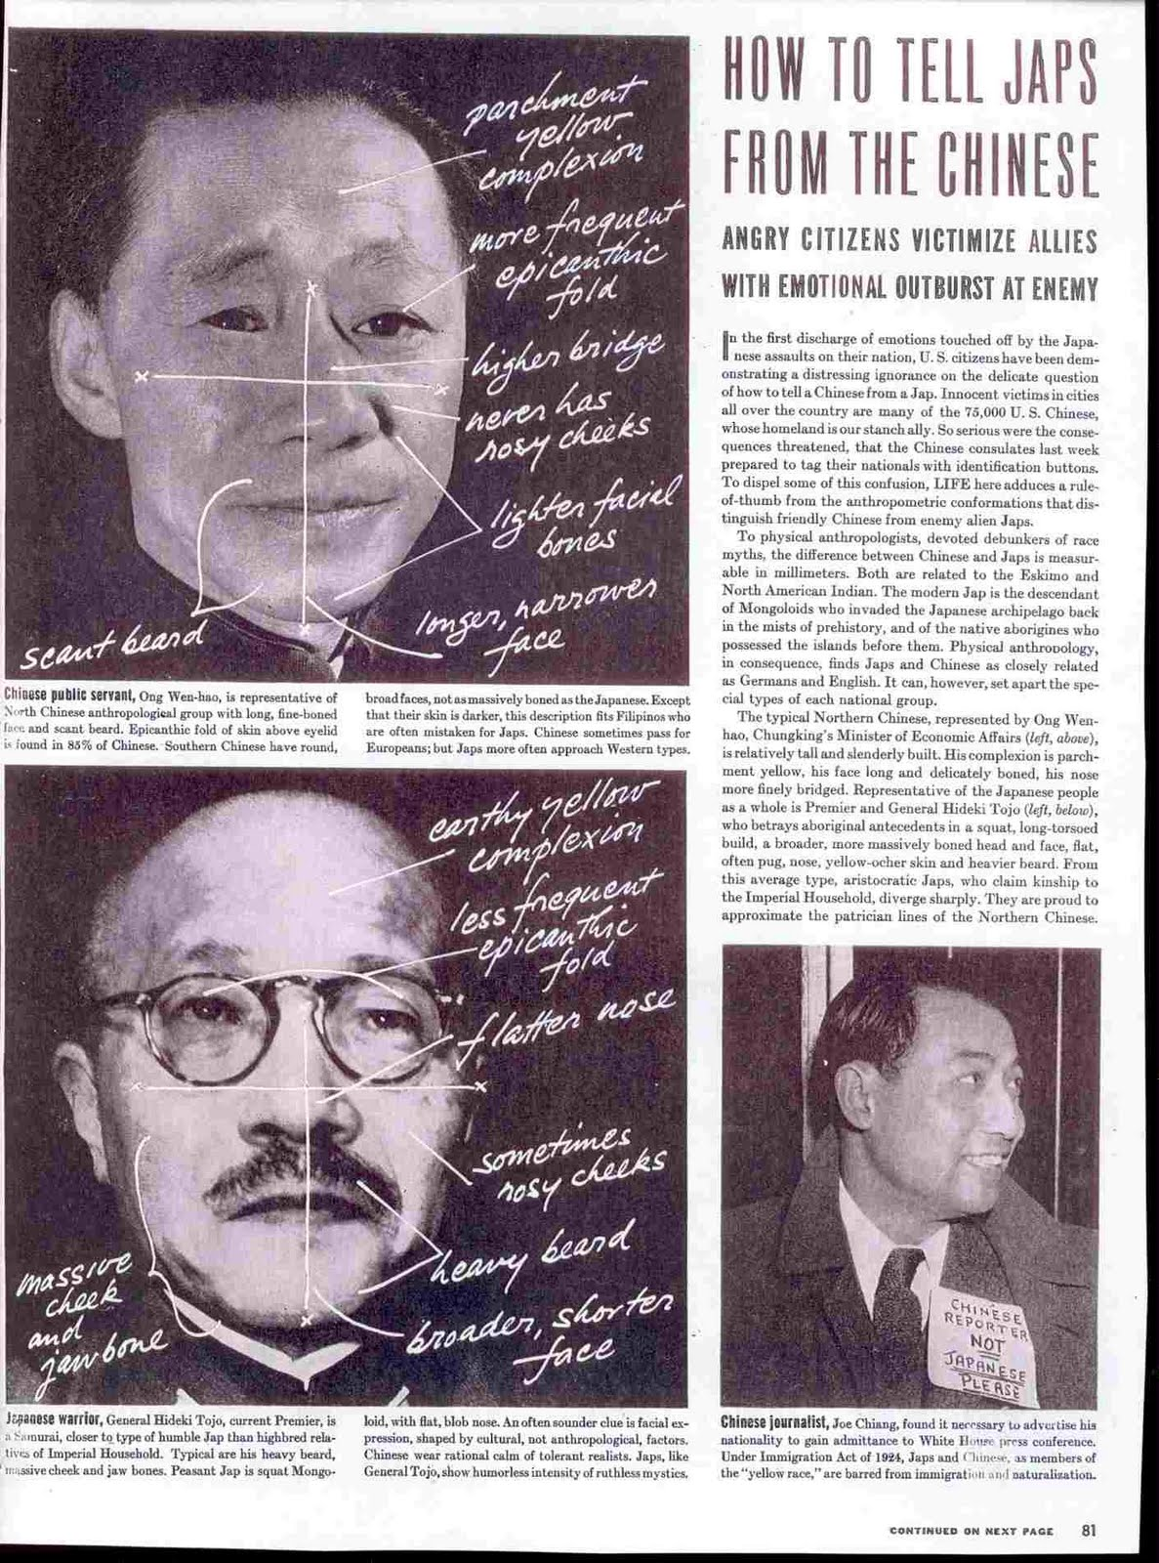

Slide 6
Gallup Poll: Chinese vs Japanese
Value | Chinese % | Japanese %
Hardworking | 69 | 46
Honest | 52 | 2
Brave | 48 | 24
Religious | 33 | 20
Warlike | 4 | 46
Treacherous | 4 | 73
Sly | 8 | 63
Intelligent | 24 | 39

Slide 7
Pearl Harbor
America Enters WWII

Slide 8
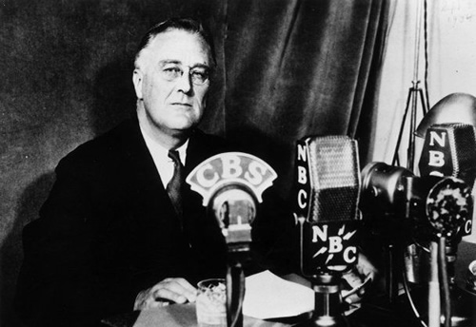
America’s stance
Hitler : Blitzkrieg
Neutral
Illegal to sell any weapons to country at war
“Preparedness”

Slide 9
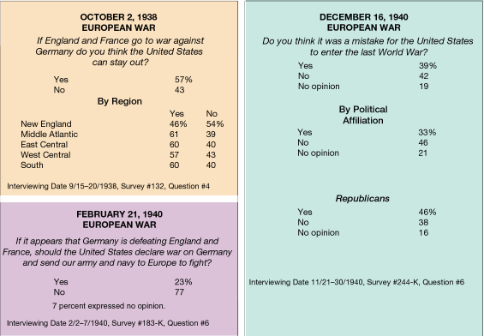

Slide 10
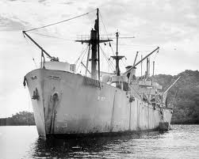
The beginnings of involvement
Cash and Carry Act: sell goods (weapons and supplies) to warring countries BUT they have to pay in cash and transport them.
Destroyers for bases (loophole)

Slide 11
Getting in further
FDR elected 3rd term
Germany getting more powerful
Britain asks for more help
Land-Lease Act: President can give aid to countries whose security is vital to our security ($40 billion)

Slide 12
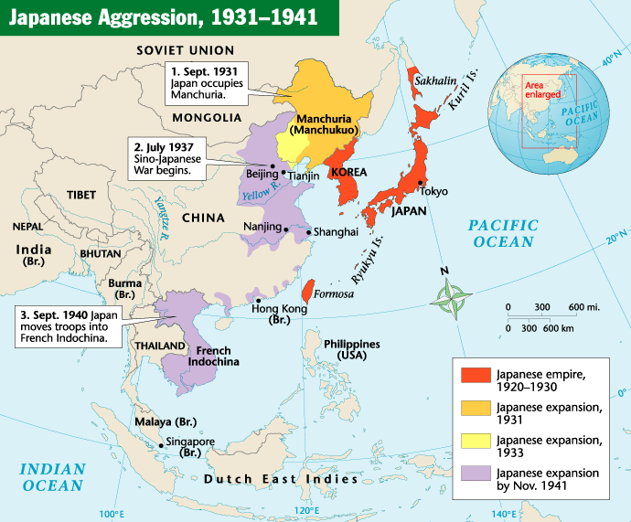

Slide 13
Japan enters the scene
Looking for raw materials, markets and land
Invade China
U.S. cuts off trade, embargo on oil
Diplomatic negotiations fail

Slide 14
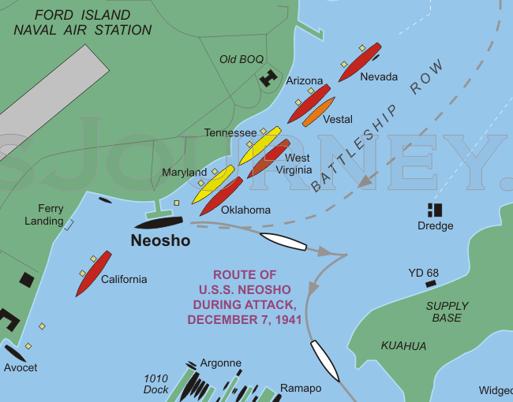
Pearl Harbor
Japan wanted complete surprise
Maximum damage
2 waves of air attacks
Midget subs

Slide 15
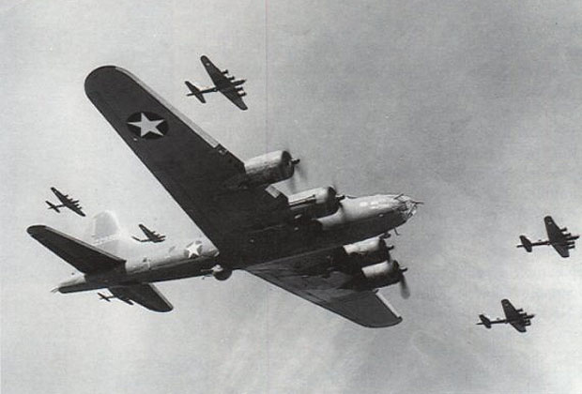
Japan’s goofs!
Sub spotted – gets away
2nd sub spotted – shot down
Planes spotted on radar – excused
Japanese naval fleet is missing

Slide 16
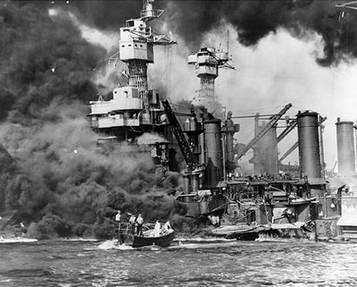
Results
Over 2,000 Americans killed
U.S.S. Arizona sunk
America enters the war UNITED.
Executive Order 9066: internment camps

