Slide 1
Ratification of the Constitution

Slide 2
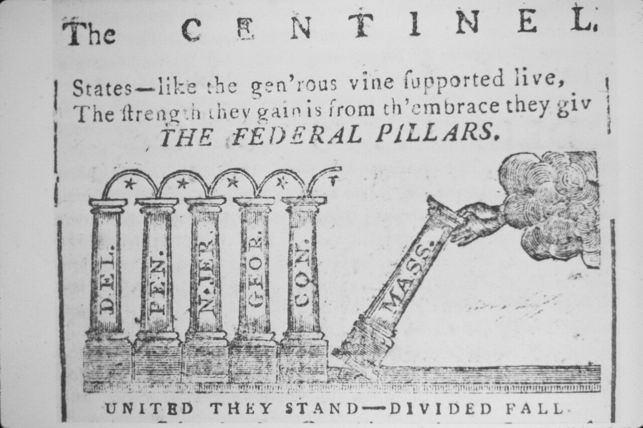
9 of 13 states must ratify

Slide 3
Federalists
Leaders: James Madison and Alexander Hamilton
In favor of the Constitution
The Articles of Confederation are too weak.
A bill of rights is not necessary.
Need strong national government.

Slide 4
Anti-Federalists
Leaders: Patrick Henry, Richard Henry Lee, John Hancock , and Samuel Adams.
Against ratifying the Constitution
A bill of rights needs to be written to protect people from the government.
The national government has too much power.

Slide 5
Federalists Win!
Agreed to Bill of Rights to protect the people’s rights from the government.
Had George Washington’s support.

Slide 6
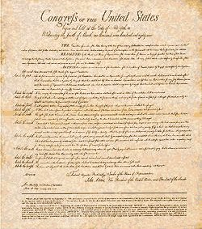
The Bill of Rights
The first 10 amendments to the Constitution

Slide 7
st Amendment
1
1. Practice any religion we want to
2. Speak freely
3. Assemble (meet)
4. Address the government (petition)
5. Publish newspapers, TV, radio, Internet (press)

Slide 8
2
nd Amendment
Protects the right to bear arms, which means the right to own a gun.

Slide 9
3
rd Amendment
We cannot be forced to house or quarter soldiers.

Slide 10
4
th Amendment
Protects the people from unreasonable searches and seizures.

Slide 11
5
th Amendment
1. Protects people from being held for committing a crime unless they are properly indicted, (accused)
2. You may not be tried twice for the same crime (double jeopardy)
3. You don’t have to testify against yourself in court. (Self-incrimination)

Slide 12
6
th Amendment
Guarantees…
1. A speedy trial (you can’t be kept in jail for over a year without a trial)
2. An impartial jury (doesn’t already think you are guilty)
3. That the accused can confront witnesses against them
4. The accused must be allowed to have a lawyer

Slide 13
7
th Amendment
Guarantees the right to a speedy civil trial.

Slide 14
8
th Amendment
Guarantees that punishments will be fair and not cruel, and that extraordinarily large fines will not be set.

Slide 15
9
th Amendment
All rights not stated in the Constitution and not forbidden by the Constitution belong to the people.

Slide 16
10
th Amendment
States that any power not granted to the federal government belongs to the states or to the people.

