Slide 1
The Great Crash
Causes of the Great Depression

Slide 2
Downward economic spiral
Decline in consumer spending
Overproduction of goods (no one is buying them)
Manufacturers lose money and have to cut back
Lay off employees
Americans lose money
Cycle continues

Slide 3
Uneven Prosperity
Rich get richer and the poor stay poor.
70-80% of families have no savings and make minimum wage.
Consumer debt is so high that people can’t afford to repay their loans
Everyone has to work to get by

Slide 4
Stock Market
Get rich quick mentality
Speculation – people are investing their life savings hoping for big returns
Buying on margin – purchasing stock for a fraction of the price and borrowing the rest
Stock market boom based on borrowed (not real) money

Slide 5
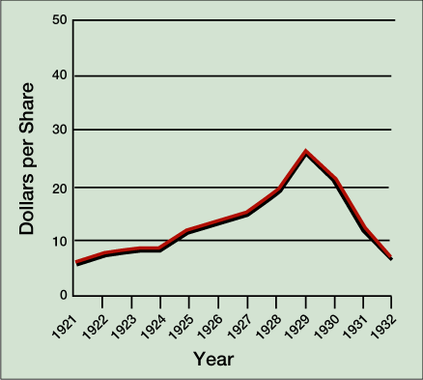
The Great Crash of 1929
May 1928-September 1929, prices doubled in value
beginning in Sept 1929, gradual slide
Black Thursday (Oct. 24)
largest sell-off in NYSE history
Black Tuesday (Oct. 29)
$40 billion in stock value lost by Dec.

