Slide 1
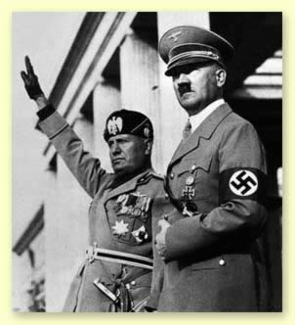
World War II Causes of the War

Slide 2
Government Structures
Each group feared and hated the others!!!
ENFORCES THROUGH TERROR
ENFORCES THROUGH TERROR
ENFORCES THROUGH LAW
Fascist
Communist
Democracy
-Nation is more important than the individual
(Work towards the benefit of the “state”)
Variety of grades
Individual is more important than the nation
Variety of grades
-Nation is more important than the individual (work towards benefit of everyone)
-Everyone gets a B+

Slide 3
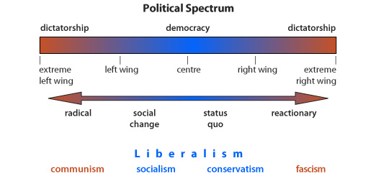
Governments throughout world

Slide 4
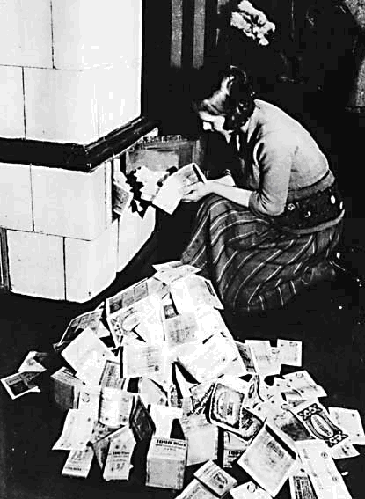
Causes of the War
Problems left from WWI
Treaty of Versailles
Punished Germany too severely, this angered them
INFLATION
$1 US to $5 German
$1 US to $4 trillion German
Germany ignores the Treaty
League of Nations ineffective
Too weak to enforce

Slide 5
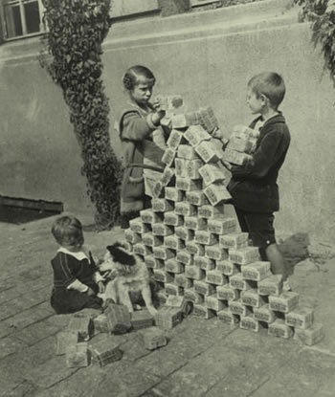
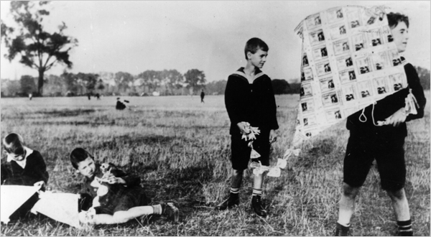

Slide 6
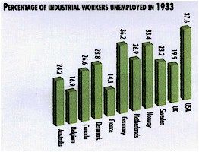
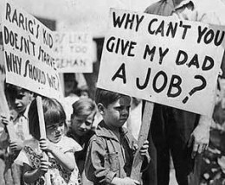
Causes of the War
Worldwide Depression
Prices were high and wages were low
High unemployment
Despair, no hope for the future
Who can help us? (FDR)

Slide 7
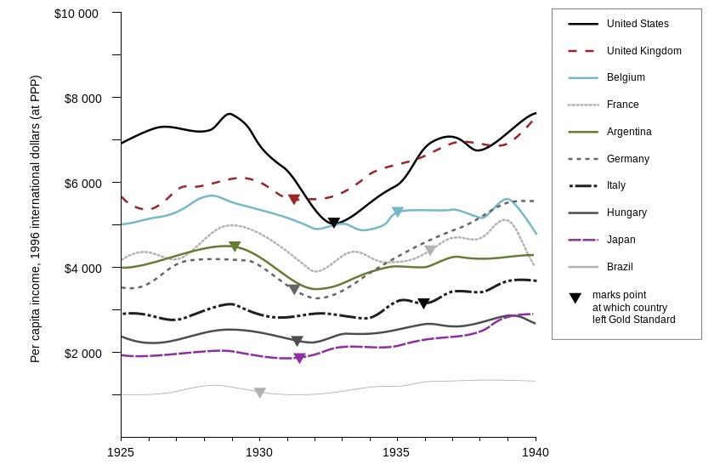

Slide 8
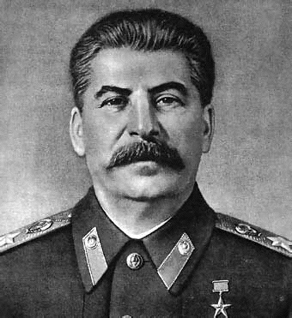
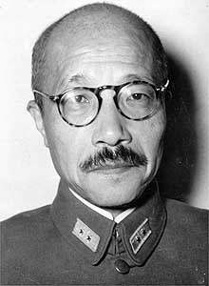
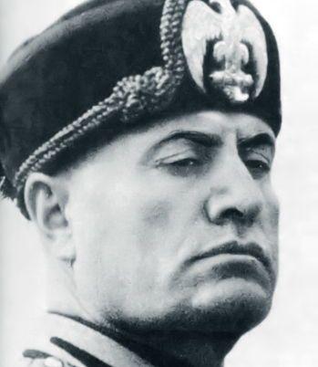
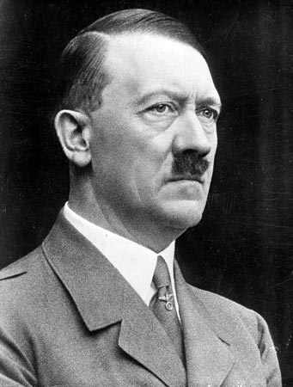
The Rise of Dictators
Totalitarian – one party has complete control
Extreme nationalism
Racism
Militarism
Expansionism
Create EMPIRE
Stalin
Tojo
Mussolini
Hitler

Slide 9
Aggression vs. Appeasement
Aggression :
a warlike act by one country against another without just cause
Appeasement :
giving in to aggression in order to avoid war. “If I let him do this one last thing, I’m sure he will stop.”
Hitler begins ignoring the Versailles Treaty by building up Germany’s armed forces. . . L.O.N. condemns it but does not stop him!
Mussolini invades Ethiopia in 1935. .. L.O.N. condemns it but does not stop him!
Japan invades Manchuria in 1937. . . L.O.N. condemns it but does not stop him!
Hitler overtakes Austria in 1938. . . L.O.N. condemns it but does not stop him!

